Slide 1
Using NOT EXISTS

Slide 2
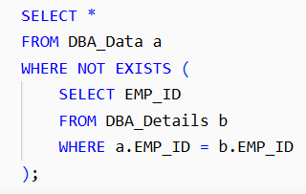
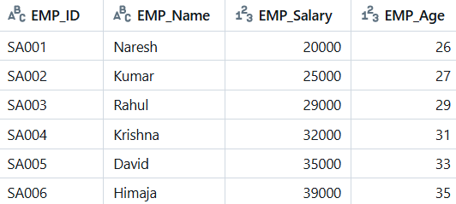
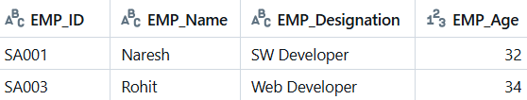
OUTER QUERY
DBA_Data
Output of INNER QUERY
FALSE
INNER QUERY
DBA_Details
EMP_ID | EMP_Name | EMP_Salary | EMP_Age
FALSE
SA001 =
SA001 =
Row 1 (SA001) of DBA_Data compares with all rows of DBA_Details.

Slide 3
DBA_Data
TRUE
EMP_ID | EMP_Name | EMP_Salary | EMP_Age
SA002 | Kumar | 25000 | 27
DBA_Details
SA002 =
TRUE
SA002 =

Slide 4
DBA_Data
FALSE
EMP_ID | EMP_Name | EMP_Salary | EMP_Age
SA002 | Kumar | 25000 | 27
DBA_Details
SA003 =
FALSE
SA003 =

Slide 5
DBA_Data
TRUE
EMP_ID | EMP_Name | EMP_Salary | EMP_Age
SA002 | Kumar | 25000 | 27
SA004 | Krishna | 32000 | 31
DBA_Details
SA004 =
TRUE
SA004 =

Slide 6
DBA_Data
TRUE
EMP_ID | EMP_Name | EMP_Salary | EMP_Age
SA002 | Kumar | 25000 | 27
SA004 | Krishna | 32000 | 31
SA005 | David | 35000 | 33
DBA_Details
SA005 =
TRUE
SA005 =

Slide 7
DBA_Data
TRUE
EMP_ID | EMP_Name | EMP_Salary | EMP_Age
SA002 | Kumar | 25000 | 27
SA004 | Krishna | 32000 | 31
SA005 | David | 35000 | 33
SA006 | Himaja | 39000 | 35
DBA_Details
SA006 =
TRUE
SA006 =

Slide 8
Using LEFT JOIN ... IS NULL

Slide 9
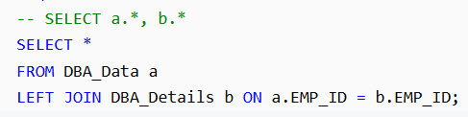
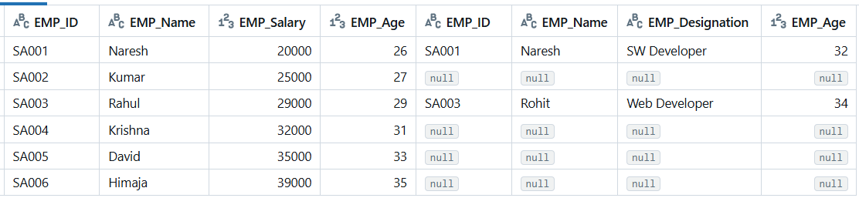
DBA_Data
DBA_Details

Slide 10
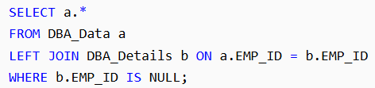
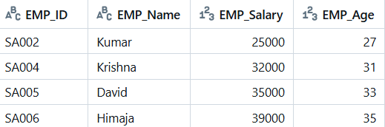

Slide 11
Using NOT IN

Slide 12
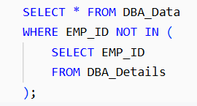
OUTER QUERY
Output of INNER QUERY
DBA_Details
EMP_ID
SA001
SA003
INNER QUERY
DBA_Data
SA001 =
SA003 =
EMP_ID | EMP_Name | EMP_Salary | EMP_Age
SA002 | Kumar | 25000 | 27
SA004 | Krishna | 32000 | 31
SA005 | David | 35000 | 33
SA006 | Himaja | 39000 | 35

